Slide 1
인공지능 2차 프로젝트
이제환, 이지훈, 박기철, 조민규

Slide 2
CONTENTS
Classification
- Iris data
- Telecom data
- Smartphone data
Employee data
Wine data
Regression
- Ames Housing data

Slide 3
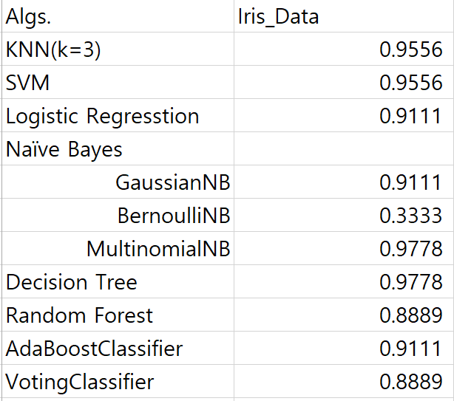
Classification – iris data
Stable model(chosen)
svm = SVC(kernel='rbf', random_state=0, gamma=.10, C=1.0)
Best but not stable
StratifiedShuffleSplit(n_splits=1, test_size=0.3, random_state=42) data 기준

Slide 4
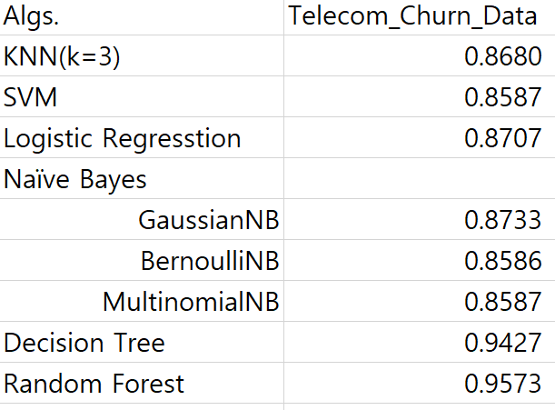
Classification - telecom data
rf= RandomForestClassifier(n_estimators = 50, criterion='entropy',random_state = 42)
Best model(chosen)
StratifiedShuffleSplit(n_splits=1, test_size=0.3, random_state=42) data 기준

Slide 5
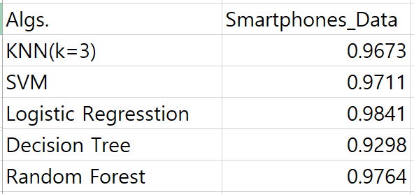
Classification - smartphone data
Best model(chosen)
StratifiedShuffleSplit(n_splits=1, test_size=0.3, random_state=42) data 기준

Slide 6
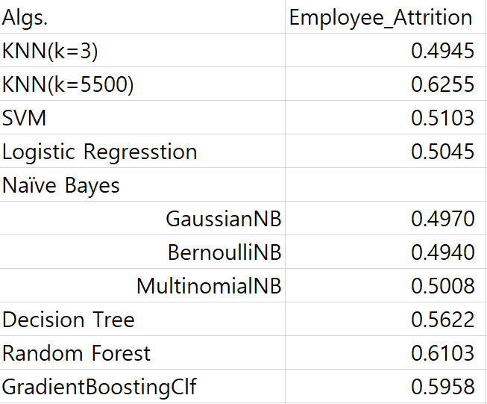
Classification - employee data
Best model(chosen)
knn = KNeighborsClassifier(n_neighbors=5500, weights='distance', leaf_size=100, algorithm='kd_tree', n_jobs=-1)
StratifiedShuffleSplit(n_splits=1, test_size=0.3, random_state=42) data 기준

Slide 7
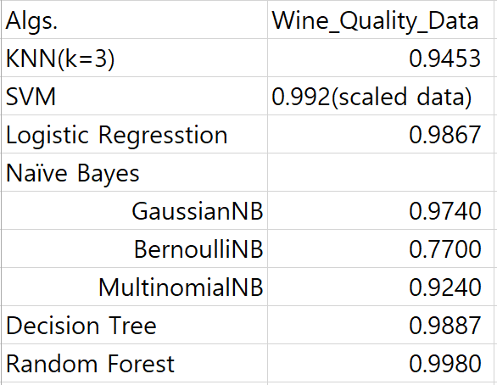
Classification - wine data
rf = RandomForestClassifier(n_estimators = 50, criterion='entropy', random_state = 42)
Best model(chosen)
StratifiedShuffleSplit(n_splits=1, test_size=0.3, random_state=42) data 기준

Slide 8
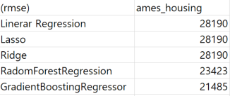
Regression - housing data
rg = GradientBoostingRegressor(random_state=42, n_estimators=140)
Best model(chosen)
project_data (test_size = 0.2) 기준

